Slide 1



TELANGANA GOVERNMENT GROWTH INSIGHTS
Created By: Hemali Patel

Slide 2
ABOUT TELANGANA

Slide 3
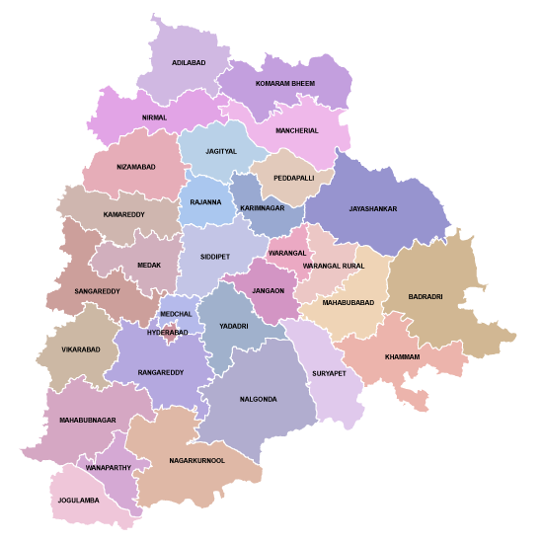
ABOUT TELANGANA
Telangana is a land rich in history, culture, and natural beauty. Formed on June 2, 2014, as the 29th state of India, Telangana has quickly emerged as an economic and cultural powerhouse in the region. Telangana has witnessed remarkable economic growth in recent years. The government's proactive policies, business-friendly environment, and infrastructure development have attracted substantial investments in sectors like pharmaceuticals, biotechnology, aerospace, and manufacturing.

Slide 4
CONTENTS
ABOUT THE PROJECT
PRIMARY RESEARCH
SECONDARY RESEARCH
01
02
03

Slide 5
ABOUT THE PROJECT
01

Slide 6
ABOUT THE PROJECT
Telangana is one of the fastest-growing states in India and one of the states with an open data policy. analyse Telangana’s growth among different sectors quantitatively and provide useful Insights to the Telangana government that would help them to make data-informed decisions that would further support the growth of the state.
Provide actionable insights to businesses, and stakeholders, enabling them to make informed decisions that can shape the future of Telangana's economic development. This project embodies the power of data analytics in driving evidence-based strategies and fostering informed decision-making for the betterment of the state and its people.

Slide 7
PRIMARY RESEARCH
02

Slide 8

STAMP REGISTRATION ANALYSIS
Document registration and estamp challan payments are significant sources of revenue for the state. The dataset provides information about the number of documents registered and the revenue generated from them. It also covers e-stamp challans, a vital component of the state's financial health.

Slide 9
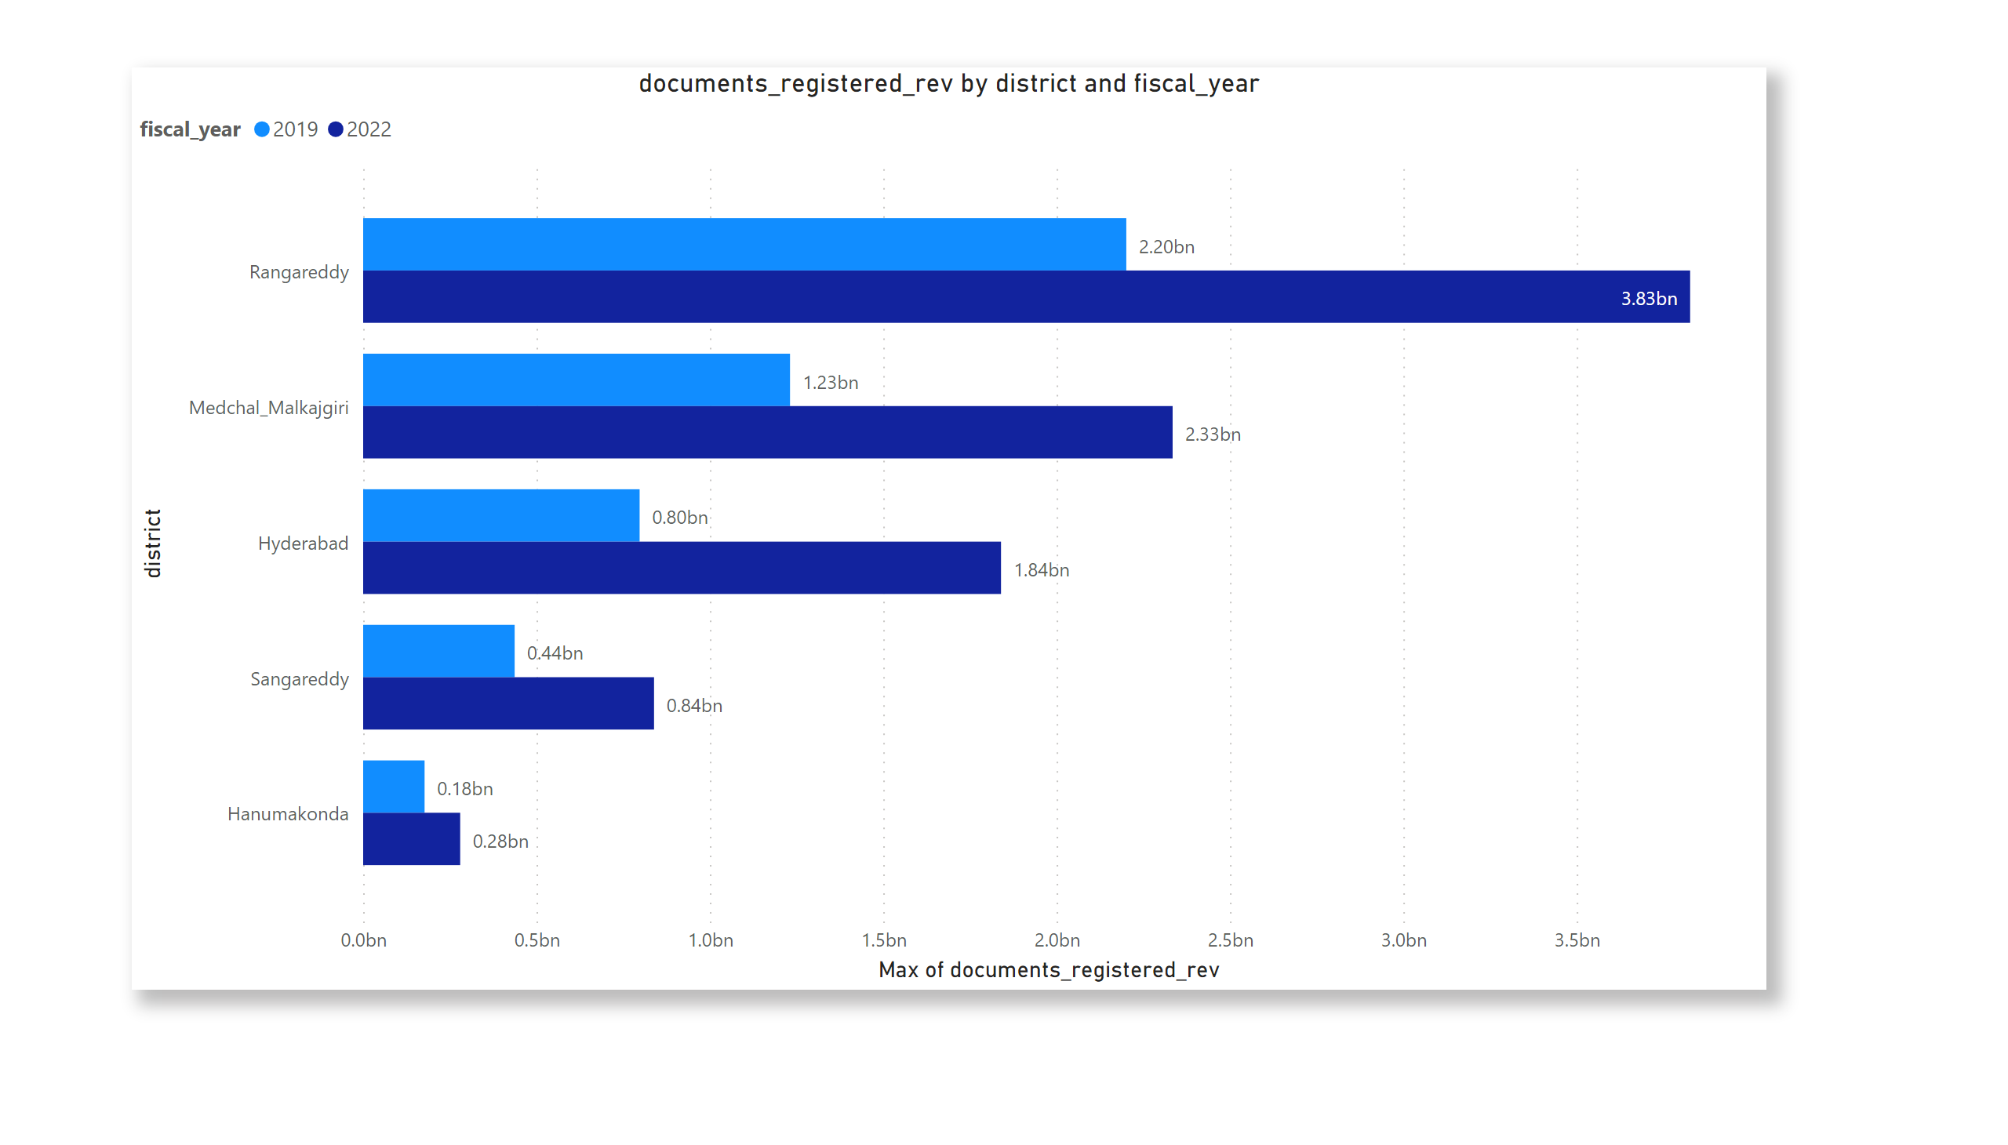
How does the revenue generated from document registration vary across districts in Telangana? List down the top 5 districts that showed the highest document registration revenue growth between FY 2019 and 2022.
01
Rangareddy
Medchal_Mlkajgiri
Hyderabad
Sangareddy
Hanumakonda

Slide 10
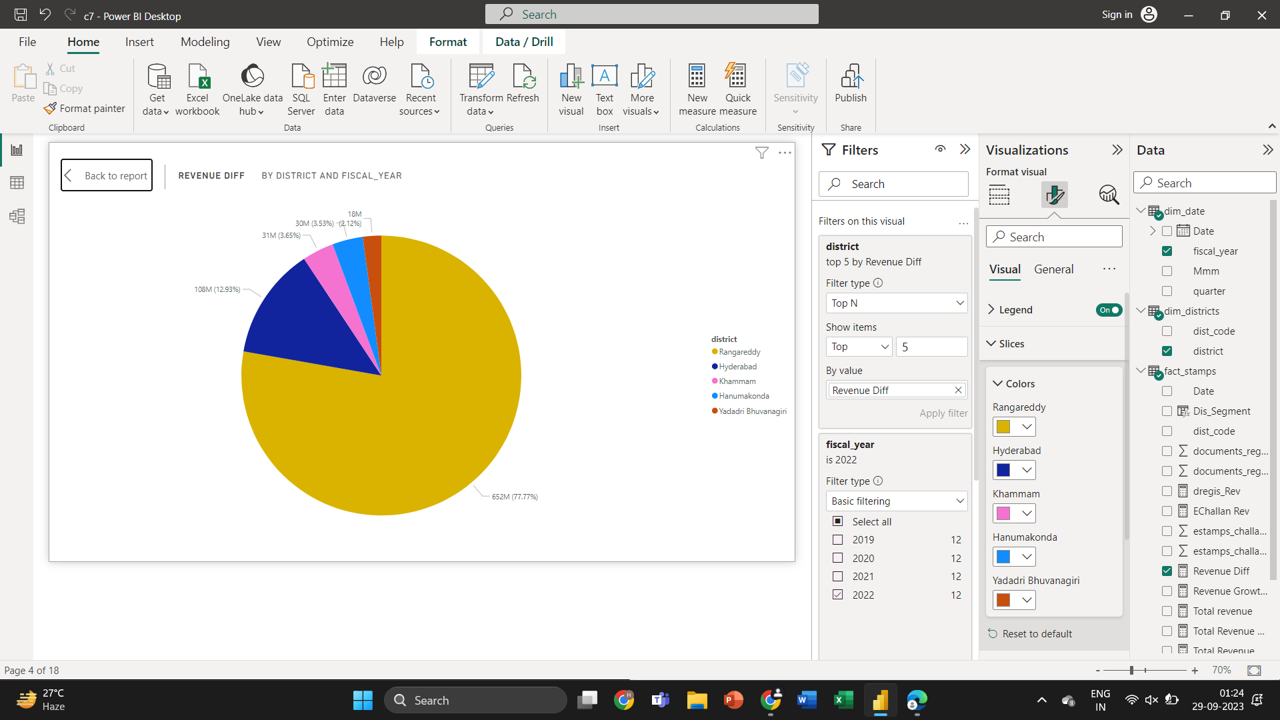
How does the revenue generated from document registration compare to the revenue generated from e-stamp challans across districts? List down the top 5 districts where e-stamps revenue contributes significantly more to the revenue than the documents in FY 2022?
02

Slide 11
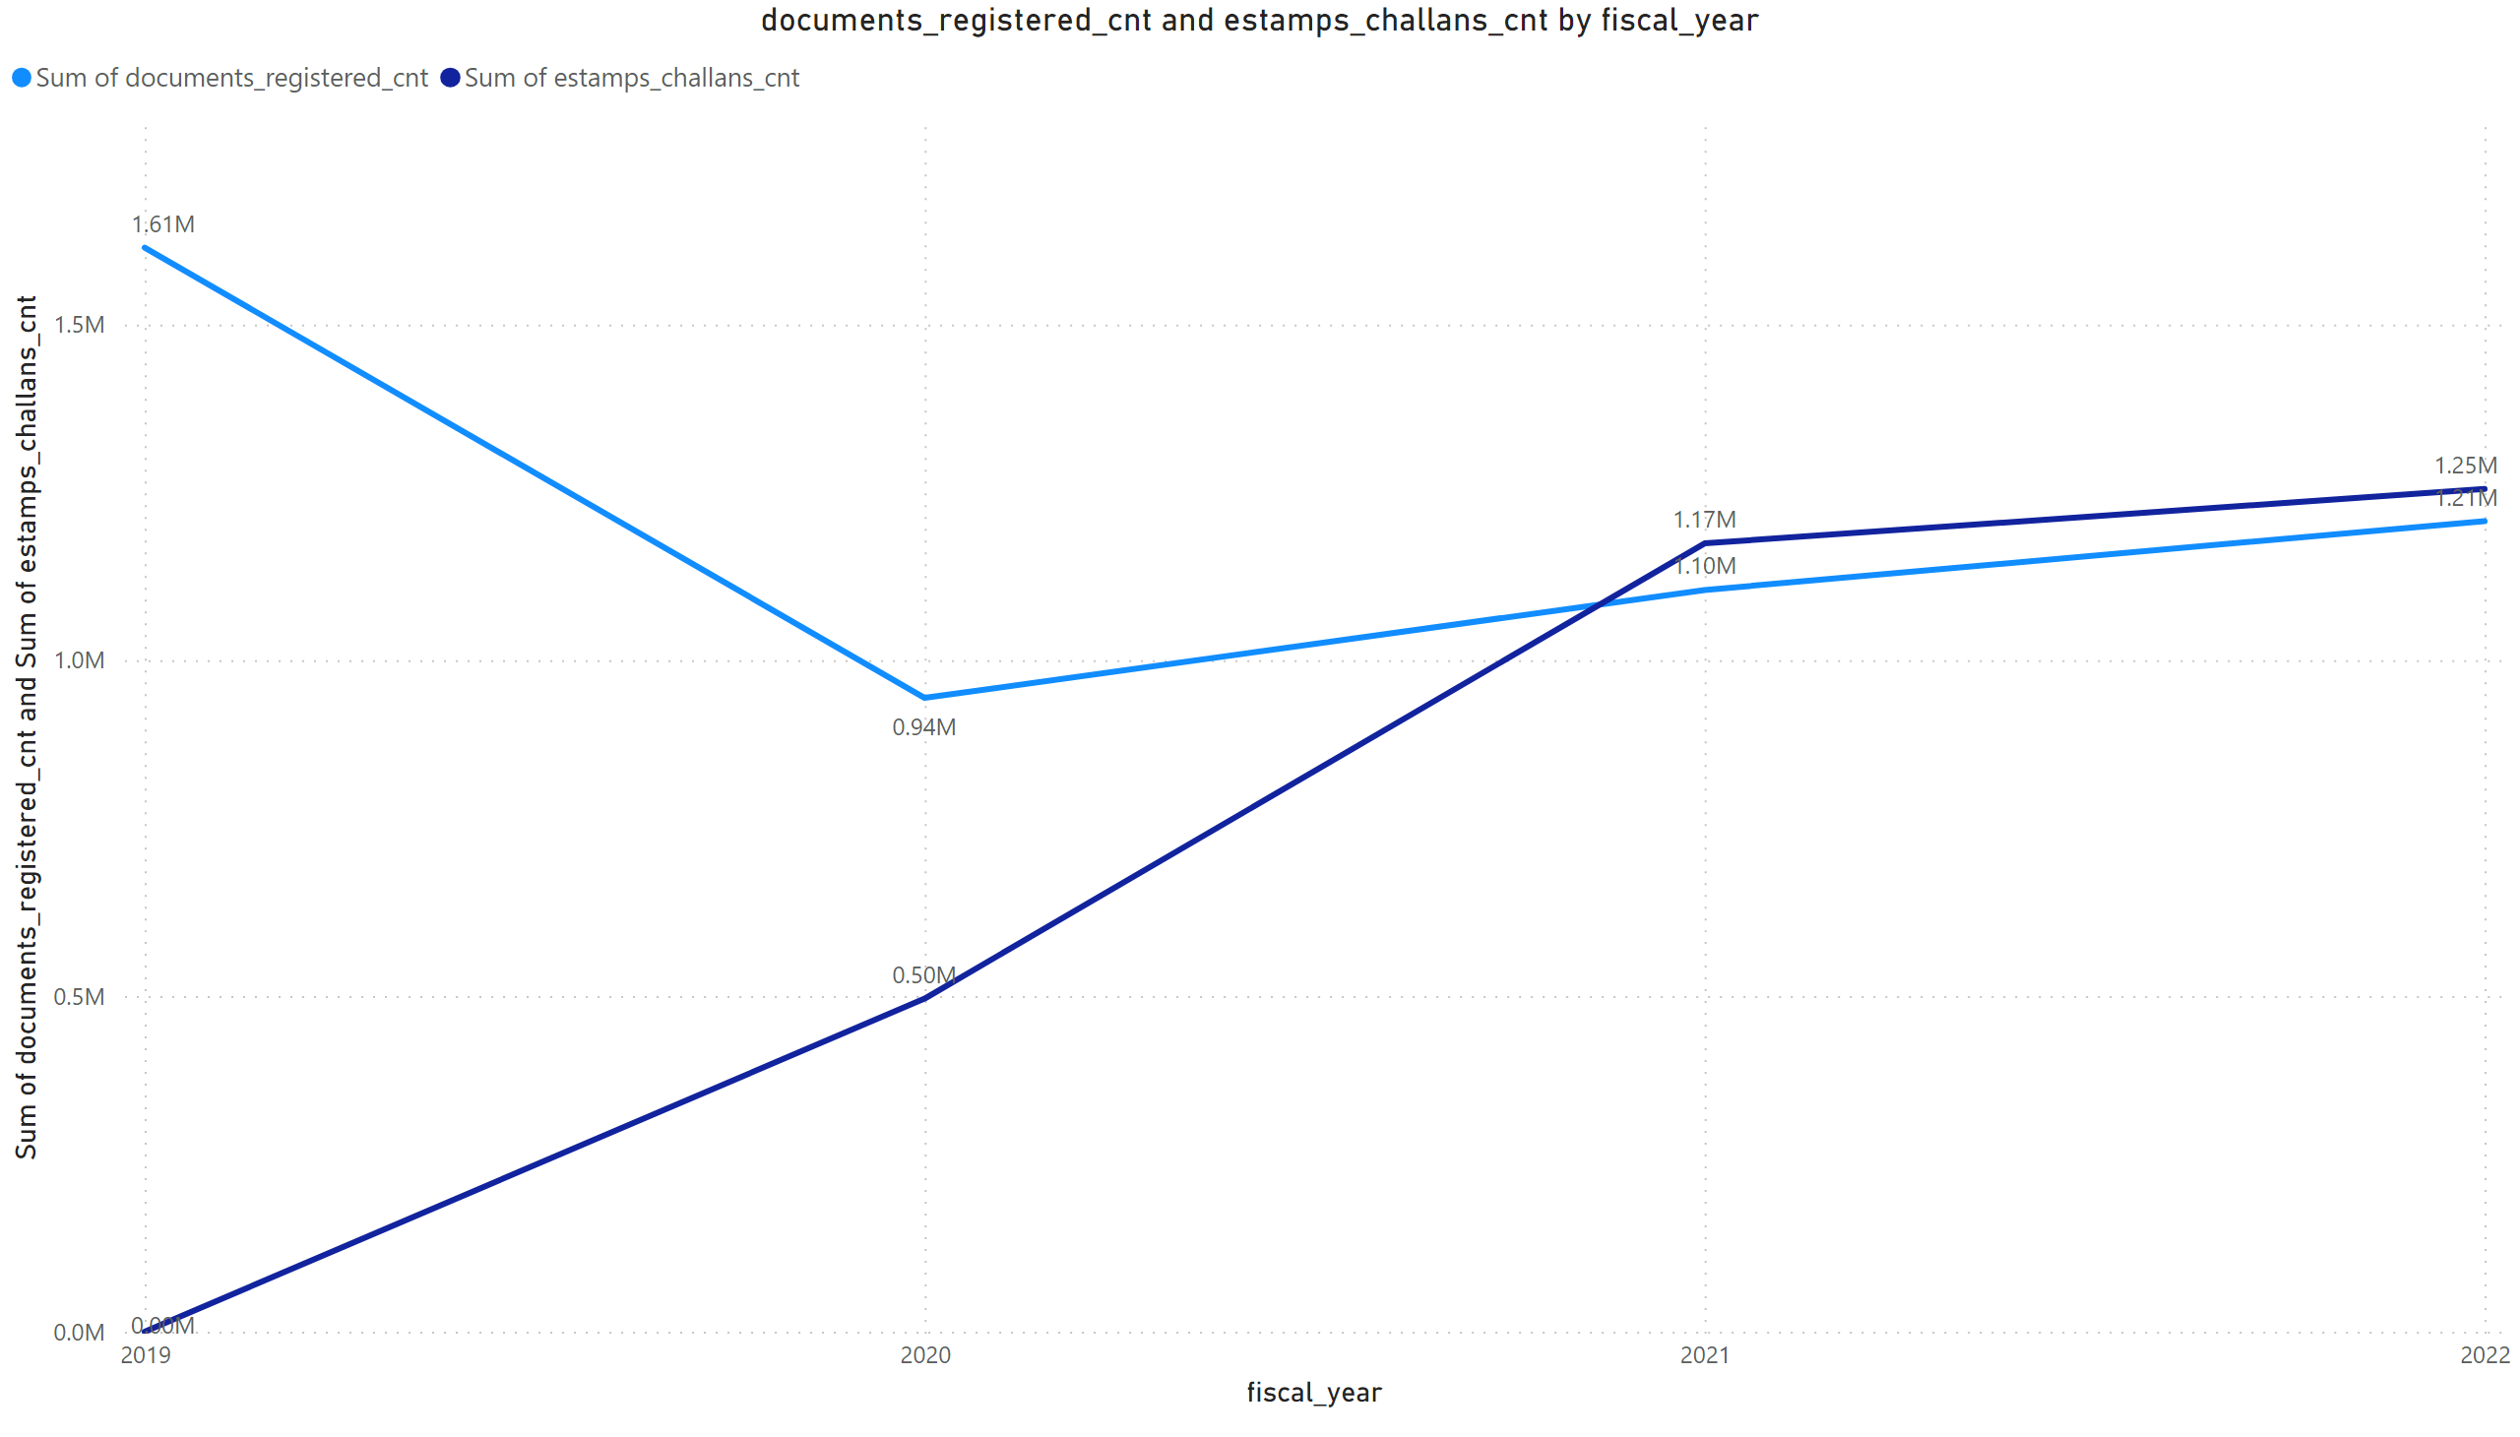
Is there any alteration of e-Stamp challan count and document registration count pattern since the implementation of e-Stamp challan? If so, what suggestions would you propose to the government?
03
The analysis indicates notable variations in e-Stamp challan and document registration counts, with 2019 showing a significant increase of 71.04% compared to 2020, the lowest year. Moreover, a negative correlation exists between these counts. In light of these findings, recommendations to the government may include a thorough assessment of the e-Stamp challan system, further investigations into the factors driving these fluctuations, and the implementation of targeted strategies to stabilize and optimize document registration processes in alignment with the goals of the e-Stamp challan system.

Slide 12
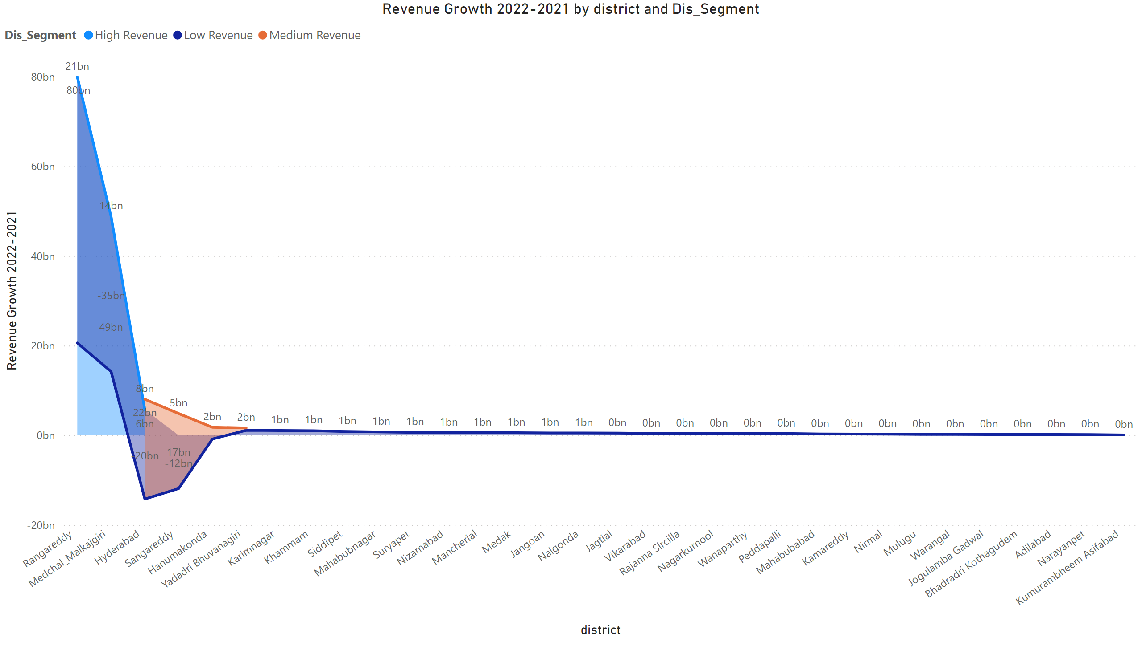
Categorize districts into three segments based on their stamp registration revenue generation during the fiscal year 2021 to 2022.
04

Slide 13
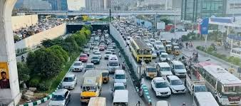
TRANSPORTATION ANALYSIS
Telangana's transportation sector plays a pivotal role in its economic growth. This dataset presents vehicle sales data categorised by fuel type, vehicle class, seating capacity, and more. It helps us track trends in the automotive industry and assess the state's environmental impact through fuel choices.

Slide 14
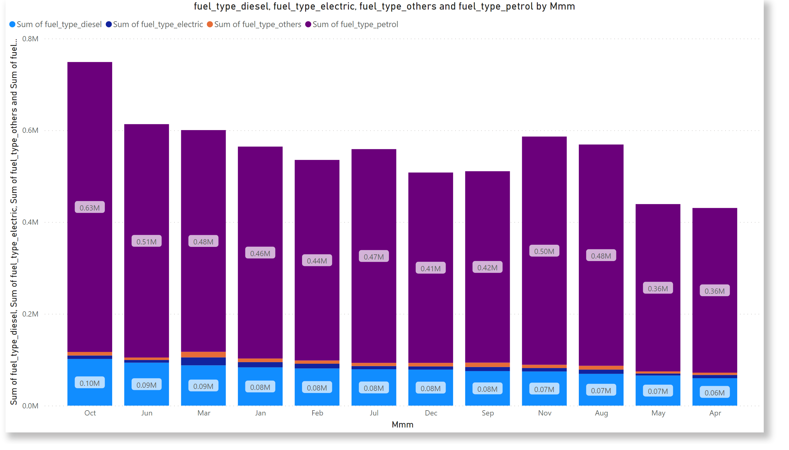
Investigate whether there is any correlation between vehicle sales and specific months or seasons in different districts. Are there any months or seasons that consistently show higher or lower sales rate, and if yes, what could be the driving factors? (Consider Fuel-Type category only)
05

Slide 15
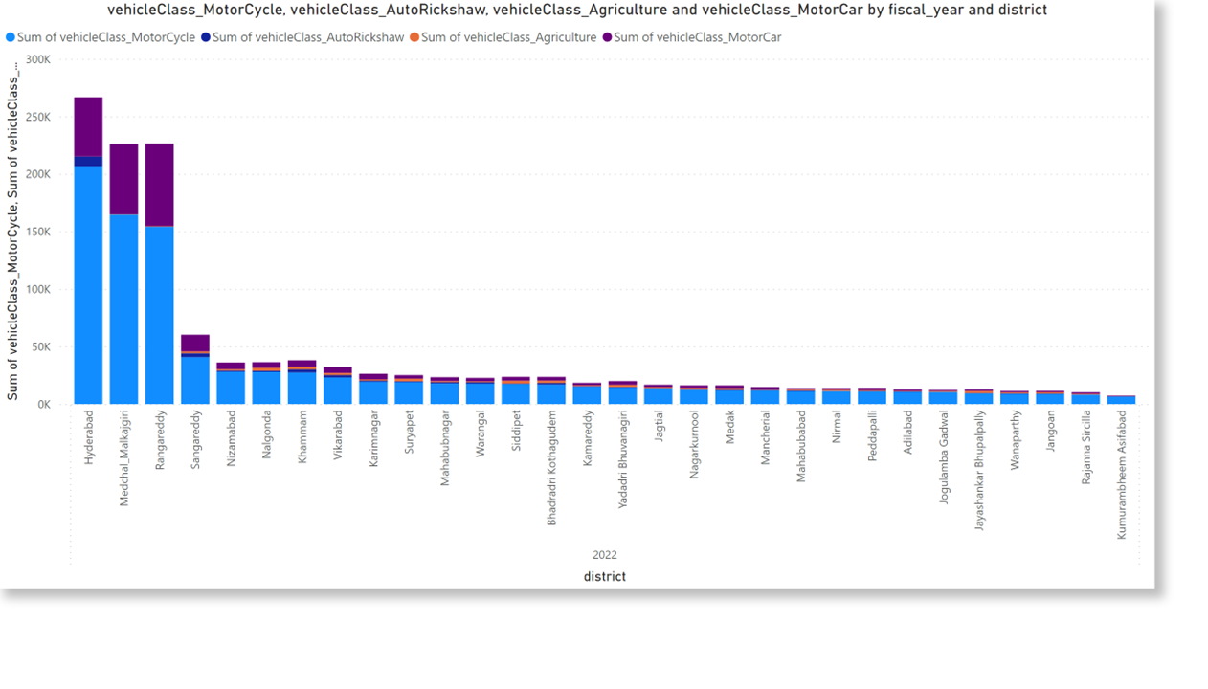
How does the distribution of vehicles vary by vehicle class (MotorCycle, MotorCar, AutoRickshaw, Agriculture) across different districts? Are there any districts with a predominant preference for a specific vehicle class? Consider FY 2022 for analysis.
06

Slide 16
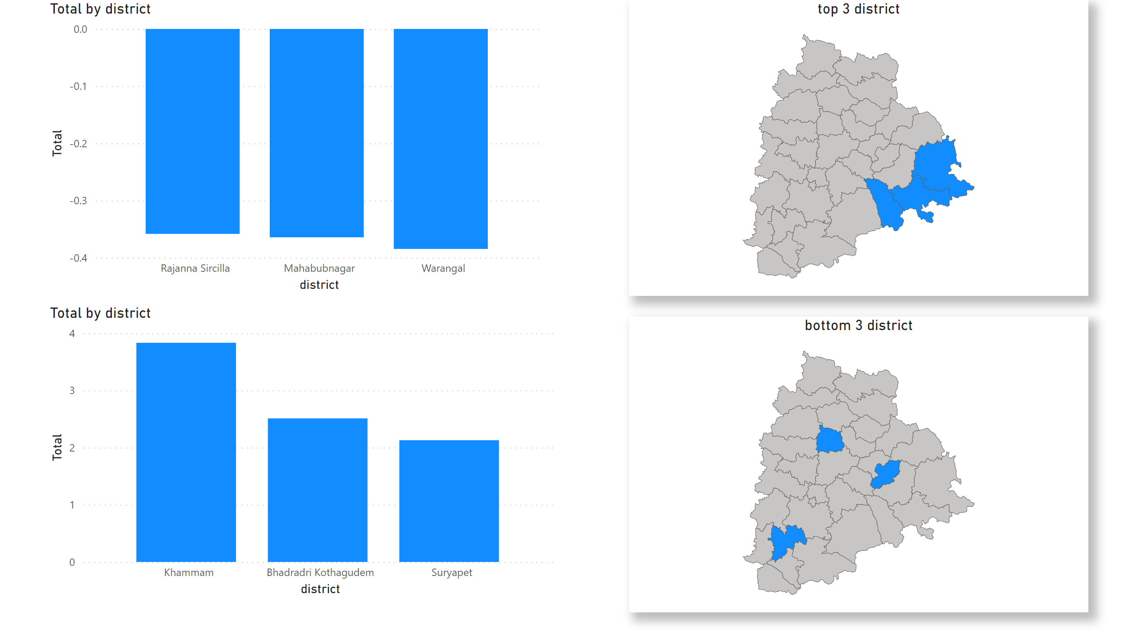
List down the top 3 and bottom 3 districts that have shown the highest and lowest vehicle sales growth during FY 2022 compared to FY 2021? (Consider and compare categories: Petrol, Diesel and Electric)
07
Khammam
Bhadradri kothagudem
Suryapet
Rajanna Sircilla
Mahabubnagar
Warangal

Slide 17

Ts-Ipass ANALYSIS
The TS-IPASS initiative is a testament to Telangana's commitment to industrial growth and investment. This dataset offers insights into sectors such as 'Automobiles,' 'Beverages,' 'Engineering,' and 'Food Processing.' We can analyze the investment made in each sector and the corresponding employment figures, providing a holistic view of the state's industrial landscape.

Slide 18
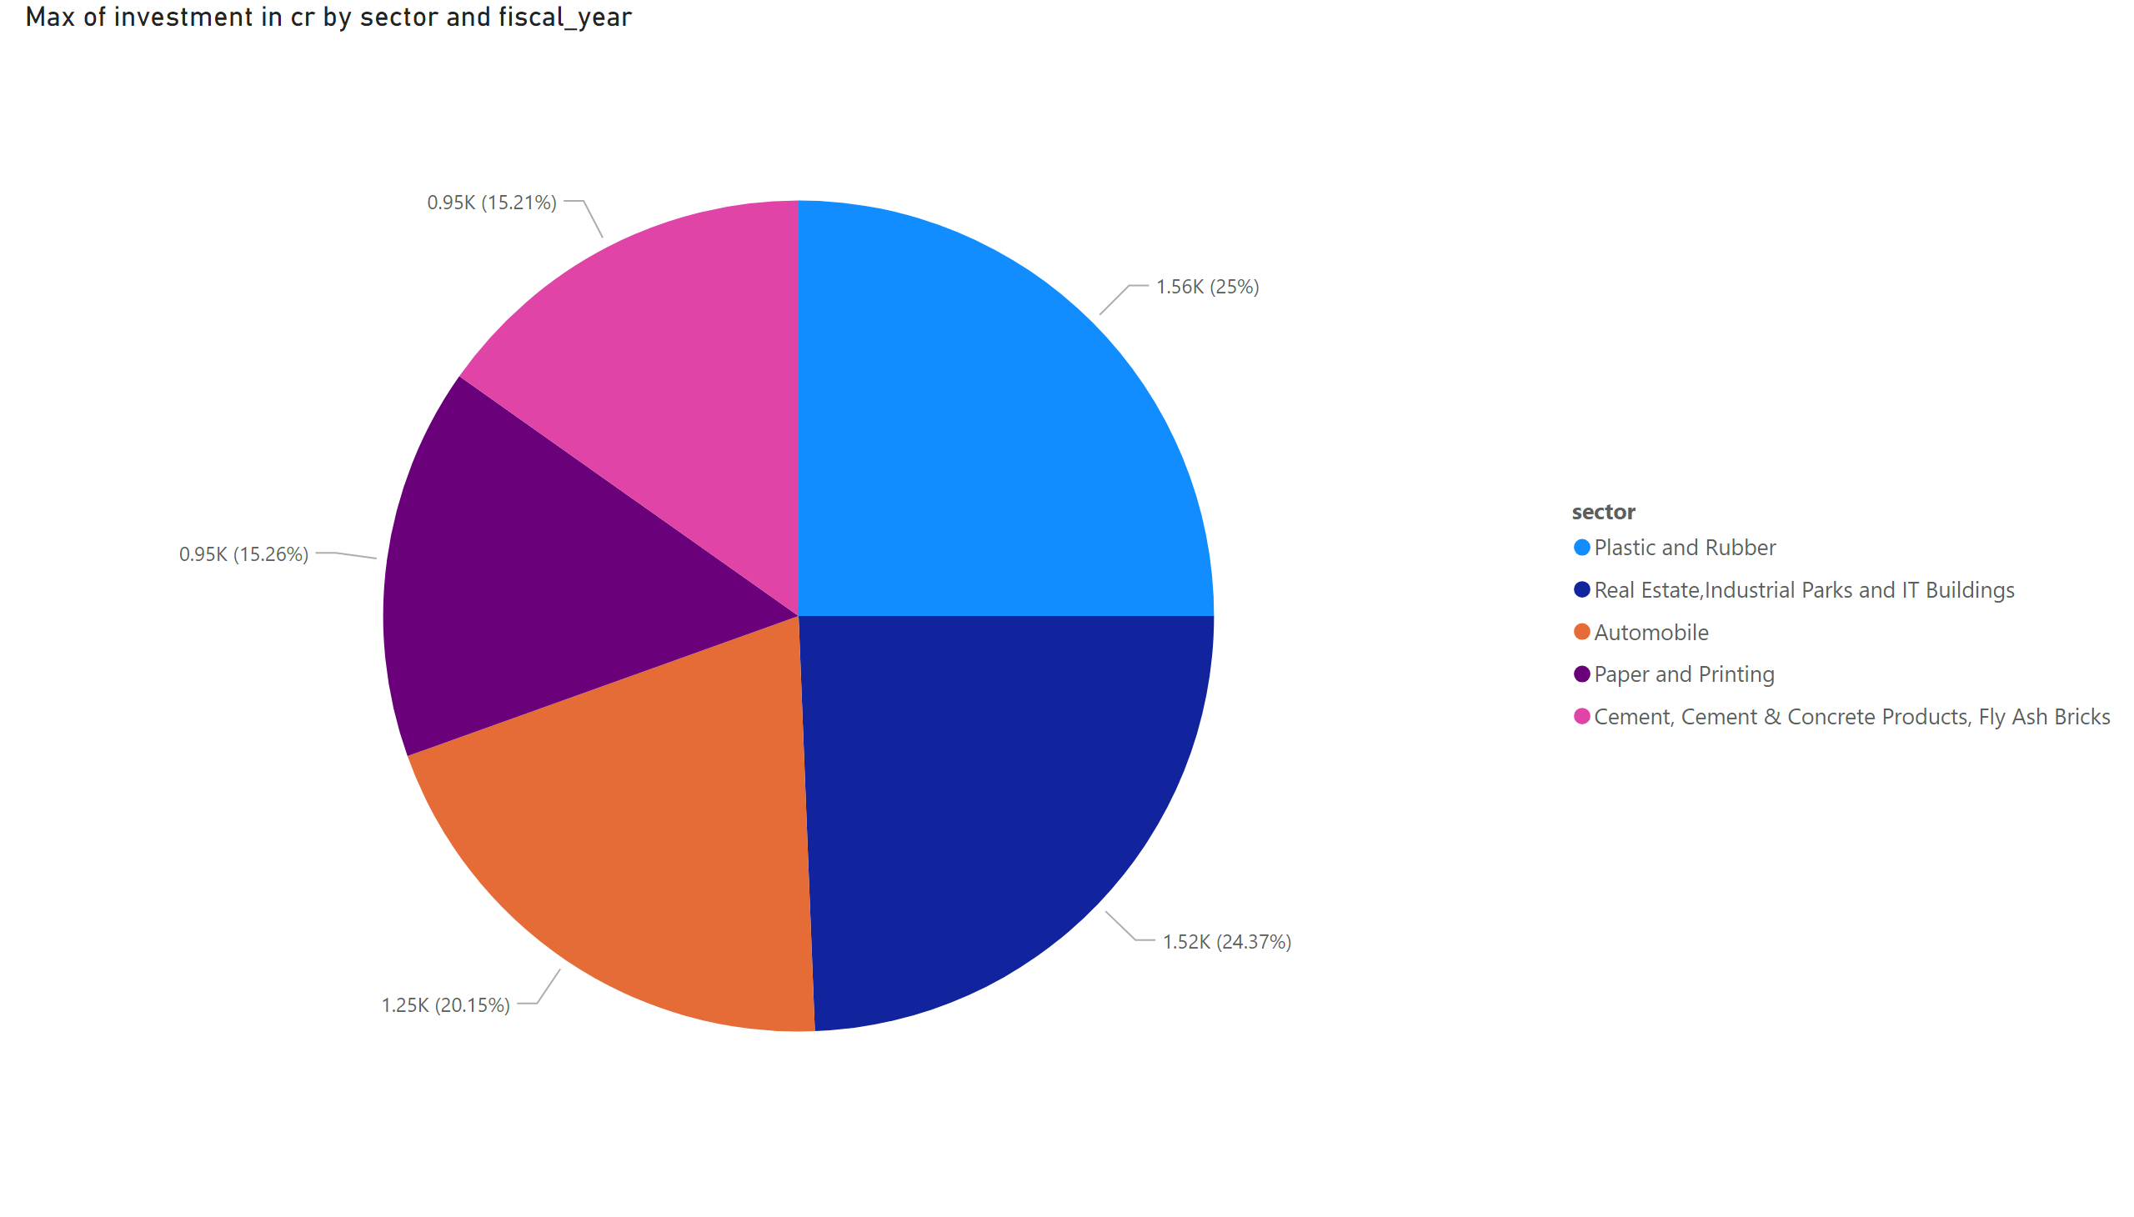
List down the top 5 sectors that have witnessed the most significant investments investments in FY 2022.
08
Plastic and rubber
Real estate ,industrial parks and it buildings
Automobile
Paper and Printing
Cement , cement and concrete products, fly ash bricks

Slide 19
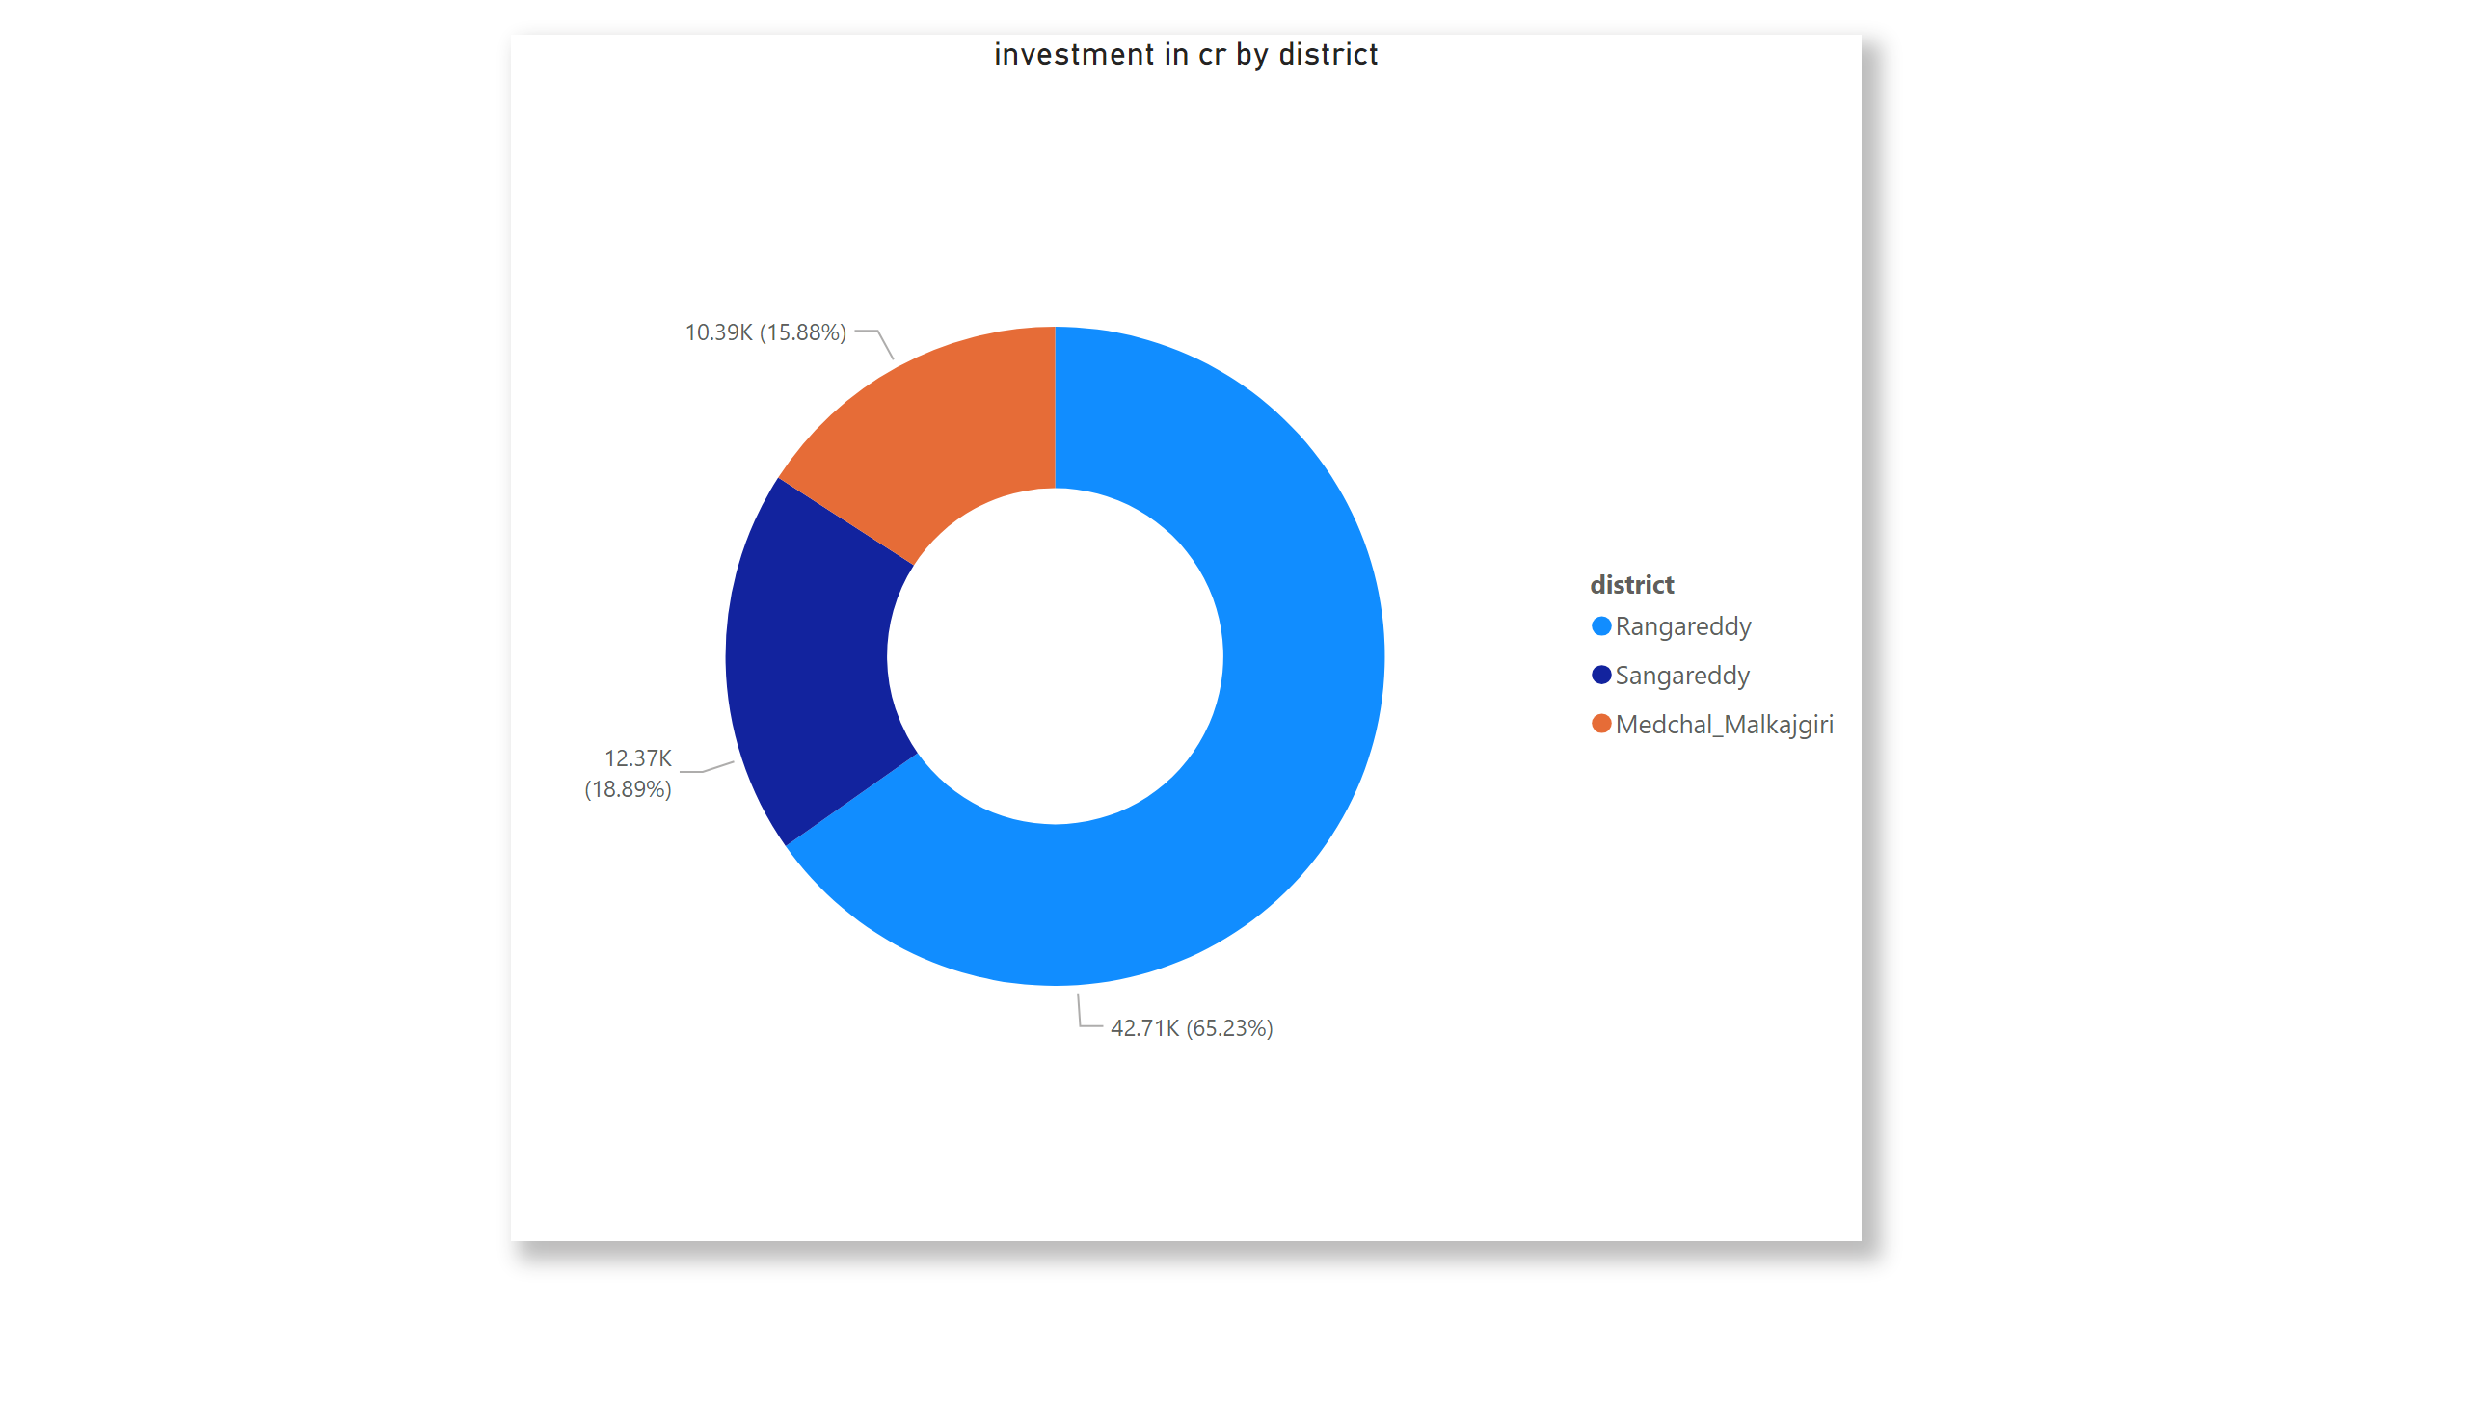
List down the top 3 districts that have attracted the most significant sector investments during FY 2019 to 2022? What factors could have led to the substantial investments in these particular districts?
09
Rangareddy, Peddapalli, and Sangareddy are likely a result of a combination of factors, including strategic location, infrastructure development, government support, a skilled workforce, and a conducive economic ecosystem. These districts have positioned themselves as attractive destinations for various industries, leading to the significant influx of investments.

Slide 20
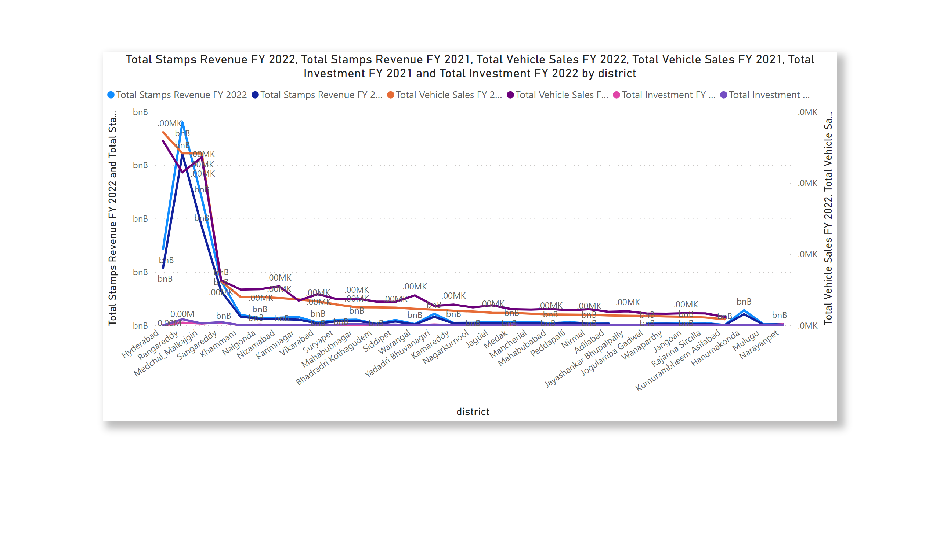
Is there any relationship between district investments, vehicles sales and stamps revenue within the same district between FY 2021 and 2022?
10
There appears to be a relationship between district investments, stamps revenue, and vehicle sales within the same district between FY 2021 and 2022, with potential for growth in districts with higher investments. However, a detailed analysis is required to establish causality and identify specific contributing factors.

Slide 21
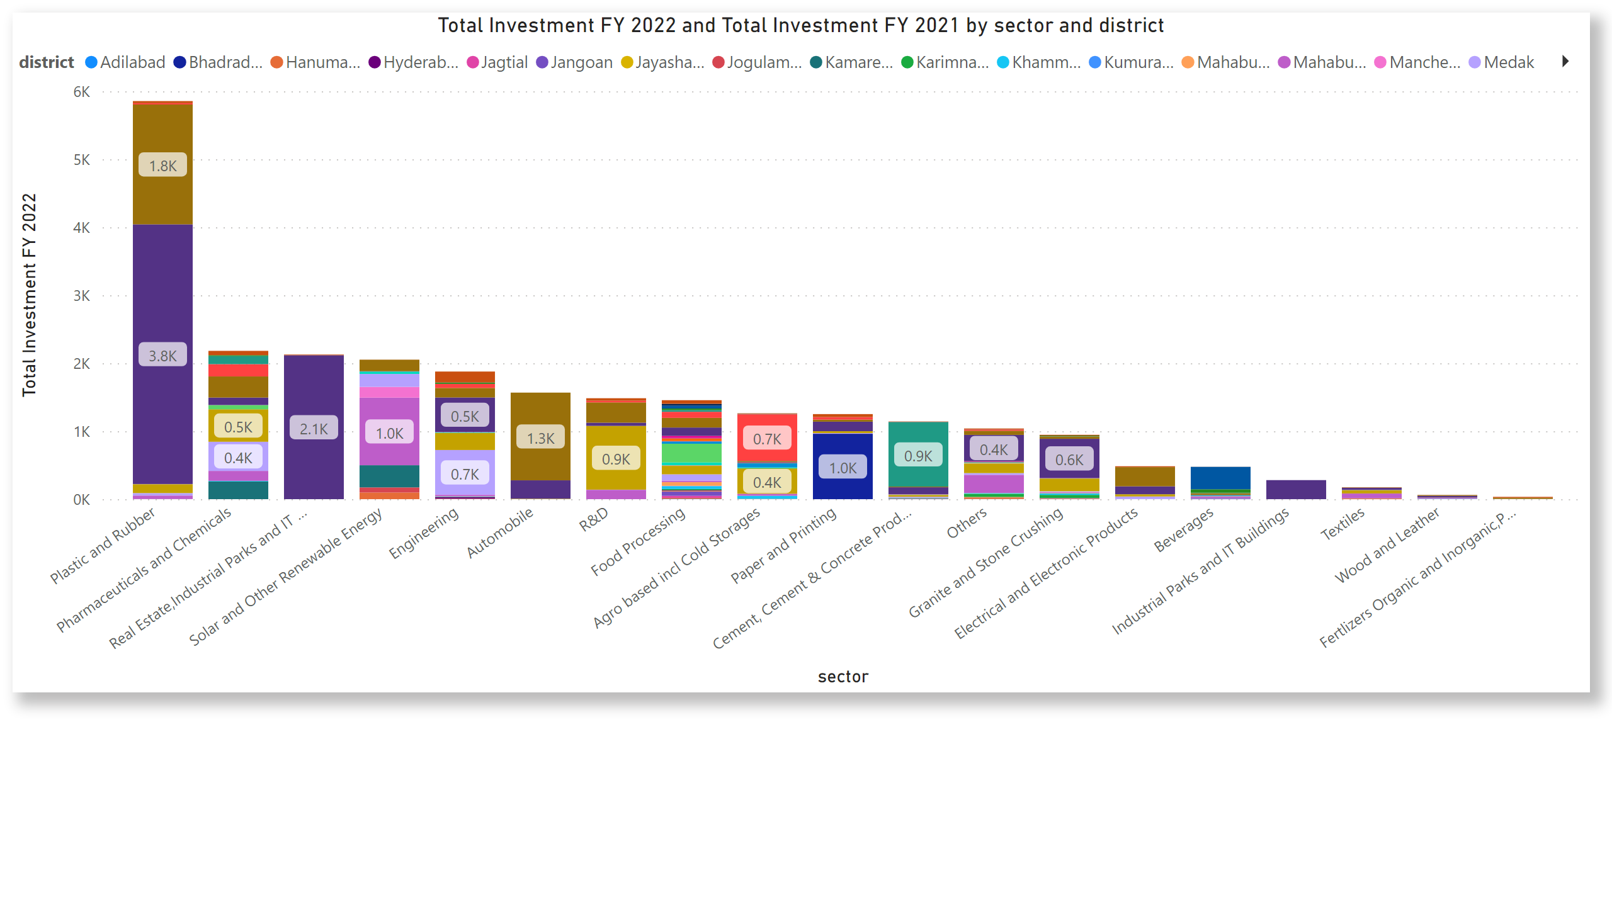
Are there any particular sectors that have shown substantial investment in multiple districts between FY 2021 and 2022?
11
Top 5 sectors are
Plastic and rubber
Pharmaceuticals and chemicals
Real estate , industrial parks and it buildings
Solar and other renewable energy
Engineering

Slide 22
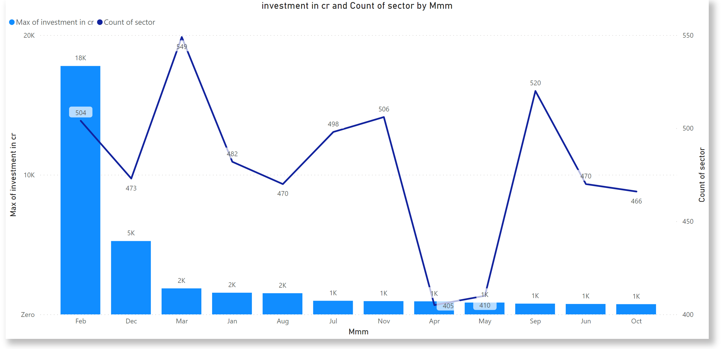
Can we identify any seasonal patterns or cyclicality in the investment trends for specific sectors? Do certain sectors experience higher investments during particular months?
12

Slide 23
SECONDARY RESEARCH
03

Slide 24
What are the top 5 districts to buy commercial properties in Telangana? Justify your answer.
01
Hyderabad: Hyderabad is the capital and economic hub of Telangana. It's a prime choice for commercial properties due to its robust infrastructure, thriving IT sector, presence of multinational corporations, and a well-developed transportation network.
Rangareddy: Adjacent to Hyderabad, Rangareddy benefits from its proximity to the capital city. It's home to industrial zones, technology parks, and commercial centers, making it an attractive location for businesses.
Medchal-Malkajgiri: This district has seen rapid development in recent years. It's strategically located and offers ample opportunities for commercial growth, particularly in sectors like real estate and retail.
Warangal Urban: With a historical significance and growing urbanization, Warangal Urban offers a unique blend of tradition and modernity. It has potential for commercial expansion, especially in sectors related to education and manufacturing.
Karimnagar: Karimnagar has been a center for educational institutions and healthcare services. It's an emerging district for commercial investments, especially in sectors related to healthcare and education.

Slide 25
What significant policies or initiatives were put into effect to enhance economic growth, investments, and employment in Telangana by the current government? Can we quantify the impact of these policies using available data?
02
Industrial Policy
TS-IPASS (Telangana State Industrial Project Approval and Self Certification System)
Investment Promotion & Facilitation Act
T-Hub and IT Parks
Hyderabad Pharma City
Rural Development and Welfare Schemes
Infrastructure Development

Slide 26
Provide top 5 Insights & 5 recommendations to Telangana government for sustained growth in the next 5 years based on your analysis.
03
Top 5 Insights:
1) Balancing Progress with Potential
2) Investment Gaps in R&D and Infrastructure
3) Capitalizing on Growing Sectors
4) Agricultural Sector Revitalization
5) Distributed Development
Top 5 Recommendations:
1) Promote Research and Development
2) Infrastructure Enhancement
3) Sector-Specific Clusters
4) Agricultural Modernization
5) Regional Development Programs

Slide 27

Credits: Codebasics team and the dataset is taken from Open Data Telangana. Thanks to the Telangana Government for providing real-time datasets for public access which is a great learning asset - feel free to explore them here. (https://data.telangana.gov.in/).

